Slide 1

AI 芯片
— GPU 细节
NVLink基础与发展
ZOMI

Slide 2
Talk Overview
硬件基础
GPU 工作原理
GPU AI编程本质
英伟达 GPU 架构
GPU基础概念
从 Fermi 到 Volta 架构
Turing 到 Hopper 架构
Tensor Code 和 NVLink 详解
GPU 图形处理
GPU 逻辑模块划分
算法到 GPU 硬件
GPU 的软件栈
图形流水线基础
流水线不可编译单元
光线跟踪流水线

Slide 3
Talk Overview
工作原理
Tensor Core – 分布式训练
Instruction Pipeline – 指令流水
CUDA Thread – CUDA 线程执行

Slide 4
Before NVLink

Slide 5
PCIe

Slide 6
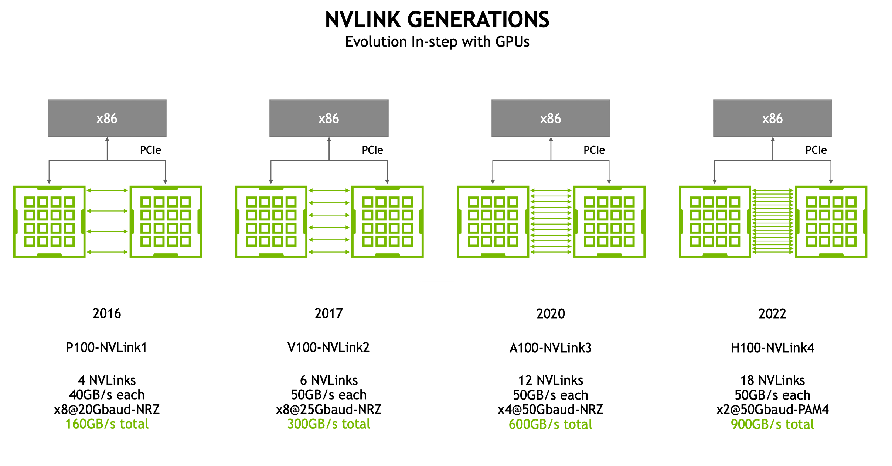

Slide 7
NVLink
结构与拓扑

Slide 8
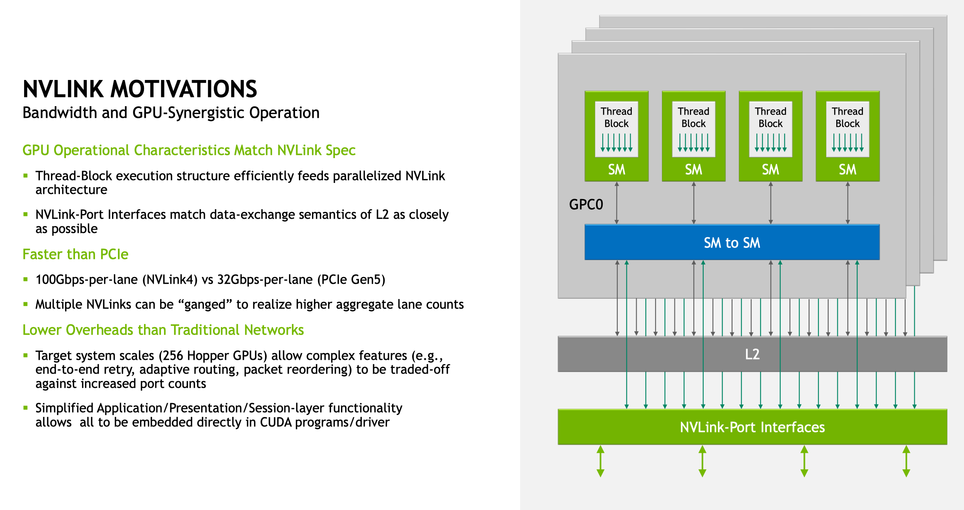

Slide 9
NVLink 结构

Slide 11
拓扑

Slide 14
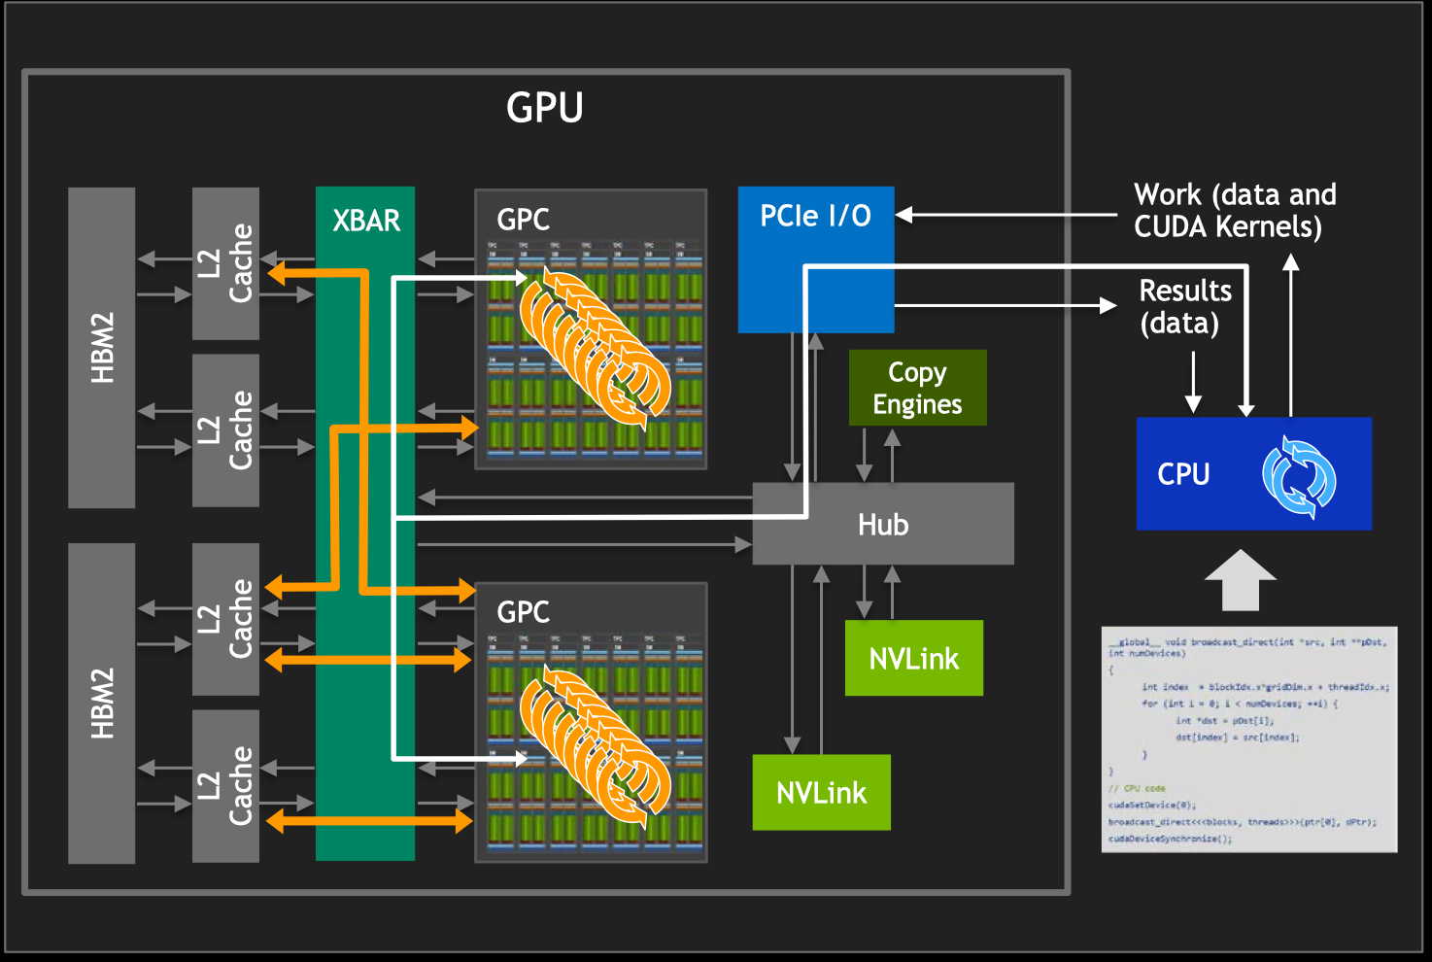
MULTI-CORE AND CUDA WITH ONE GPU
Users explicitly express parallel work in NVIDIA CUDA ®
GPU Driver distributes work to available Graphics Processing Clusters (GPC)/Streaming Multiprocessor (SM) cores
GPC/SM cores can compute on data in any of the second- generation High Bandwidth Memories (HBM2s)
GPC/SM cores use shared HBM2s to exchange data

Slide 15
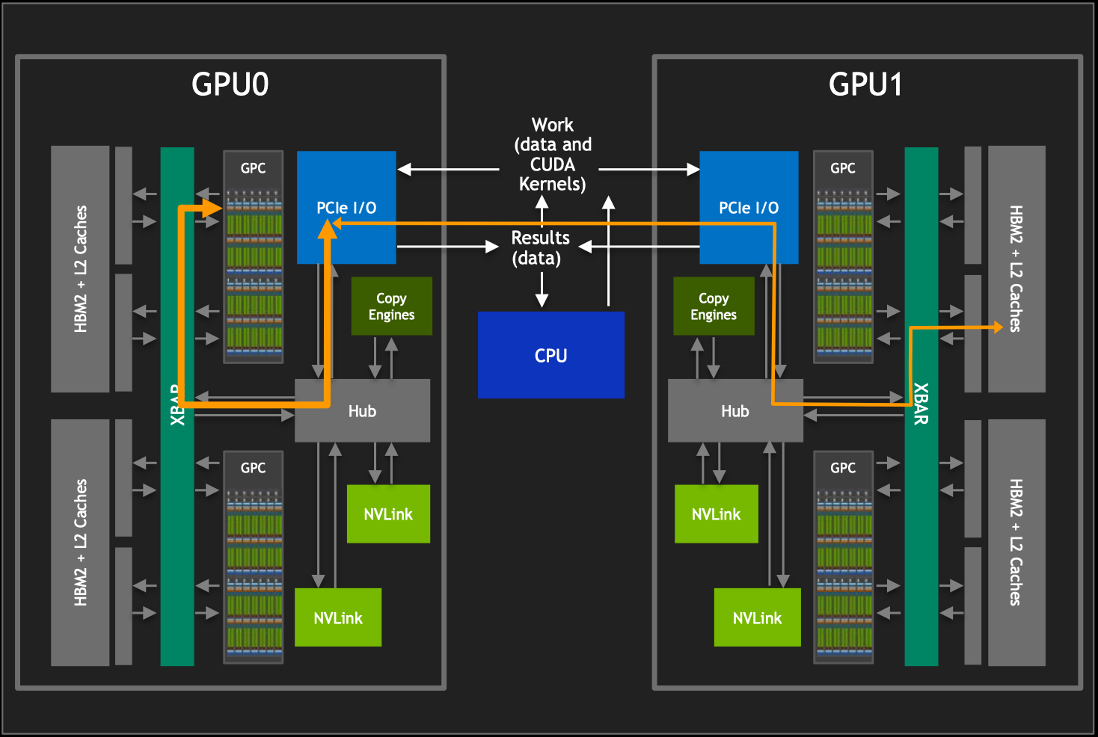
TWO GPUS WITH PCIE
Access to HBM2 of other GPU is at PCIe BW (32 GBps (bidirectional))
Interactions with CPU compete with GPU-to-GPU
PCIe is the “Wild West” (lots of performance bandits)

Slide 16
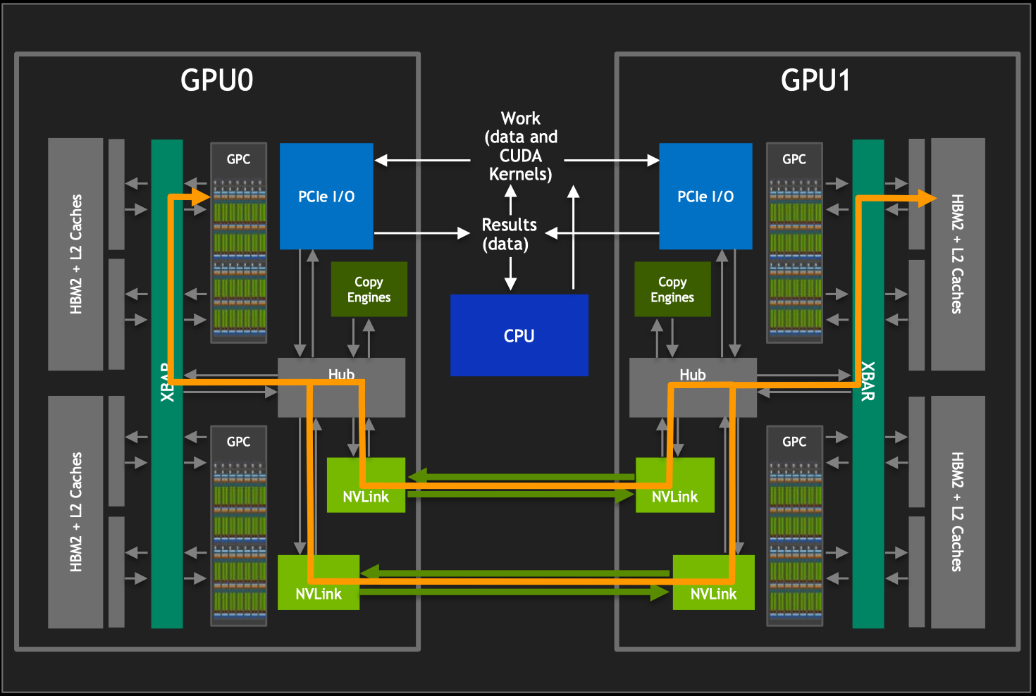
TWO GPUS WITH NVLINK
All GPCs can access all HBM2 memories
Access to HBM2 of other GPU is at multi-NVLink bandwidth (300 GBps bidirectional in V100 GPUs)
NVLinks are effectively a “bridge” between XBARs
No collisions with PCIe traffic

Slide 17
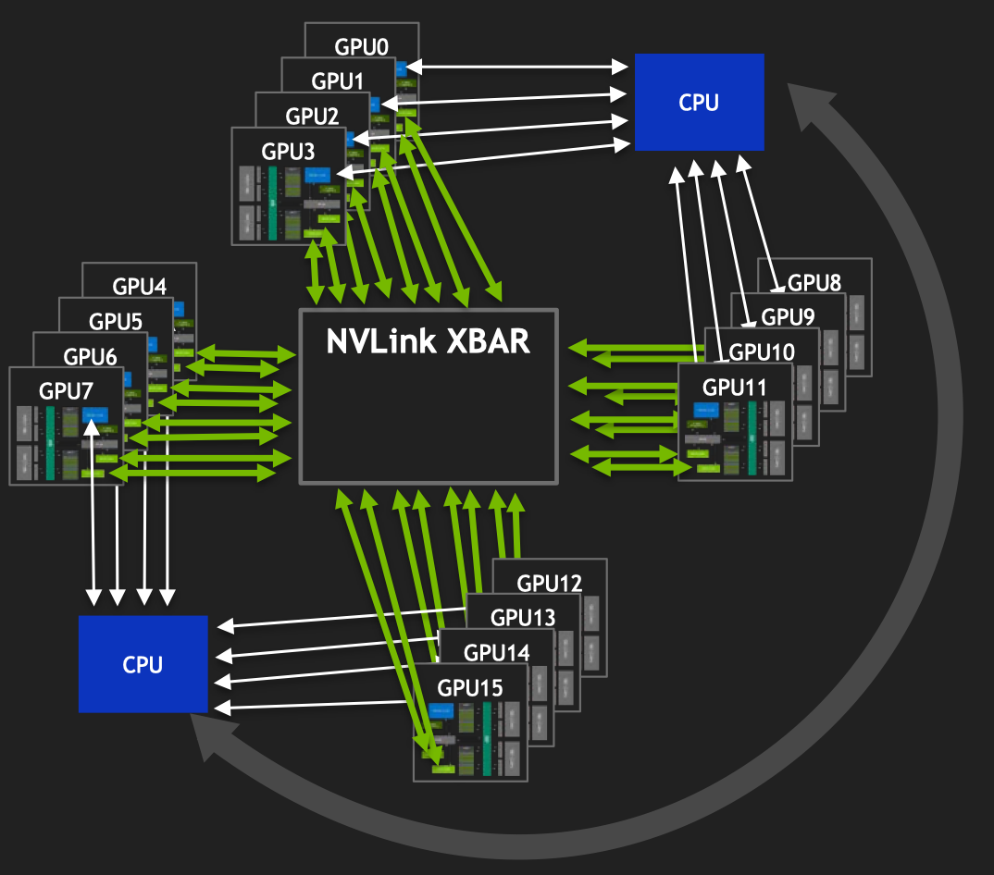
Highest number of GPUs possible
Single GPU Driver process controls all work across all GPUs
From perspective of GPCs, all HBM2s can be accessed without intervention by other processes (LD/ST instructions, Copy Engine RDMA, everything “just works”)
Access to all HBM2s is independent of PCIe
Bandwidth across bridged XBARs is as high as possible (some NUMA is unavoidable)

Slide 18
Reference 引用&参考

Slide 19
Notes:
19

